Slide 1
Dynamic Model Builders
Department of Chemical and Biomolecular Engineering

Slide 2
Current Status
Dynamic Model Builder code has been compiled on Titan
Run time – once thru reactor simulation
40 seconds on Windows
Visual C++ compiler
Debug mode (need to test release)
4 seconds on Titan
PGI compiler

Slide 3
Current Work - Benchmarking
Better benchmark requires longer runtime
Run parameter tuning on current, small model
Many solutions of the model, varying kinetic parameters
A bit hard to benchmark because the tuning algorithm has some fundamental randomness.
Run Dynamic Model Builder on a larger model
Once-thru model run, more differential equations

Slide 4
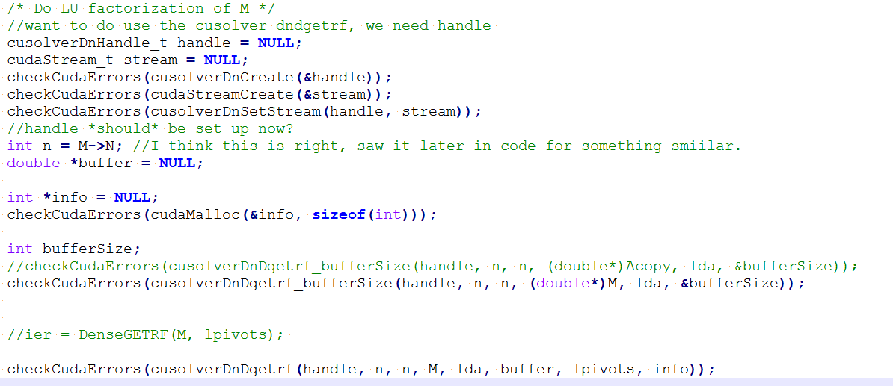
Current Work – GPU
Implementation of CuSolver in ODE solver
Goal: Add LU Decomposition from CuSolver to our ODE solver package
Currently still writing, need to debug after benchmarking

